Slide 1

CIS 404 Capstone Project
Presented by Jerry C

Slide 2
Table of contents
01
Project Outline
02
SDLC Implementation
03
Project Management: Jira
04
Design Algorithm & Demo

Slide 3
Project Outline
How can user preferences be accurately understood and catered to?
Increase user engagement and retention on Netflix
Data Collection
Data Analysis
Personalization
User Interaction Data
Behavioral Analysis
Content Recommendations
User Demographics
Segmentation
User Interface Customization
Feedback Mechanisms
Sentiment Analysis
Adaptive Algorithms

Slide 4
SDLC Implementation
SDLC
Software Development Life Cycle
Maintenance
M
P
Planning
Error correction and database update
Objective Definition and feasibility study
Testing
T
A
Analysis
Unit and performance testing
Collect data sets and define problem
Implementation
I
D
Design
Develop the system using Python
Design algorithm and system architecture

Slide 5
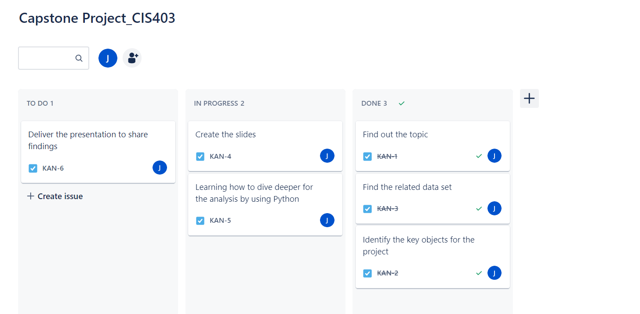
Project Management: Jira

Slide 6
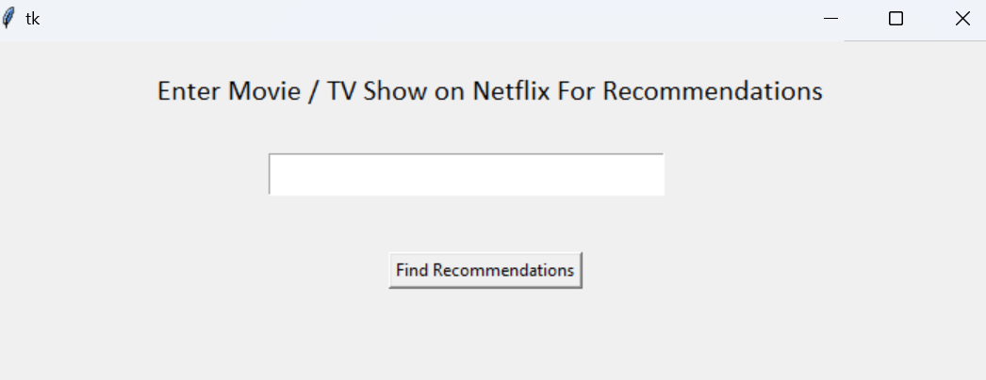
Design Alorithm & Demo

Slide 7
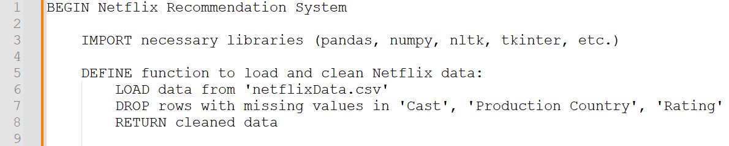
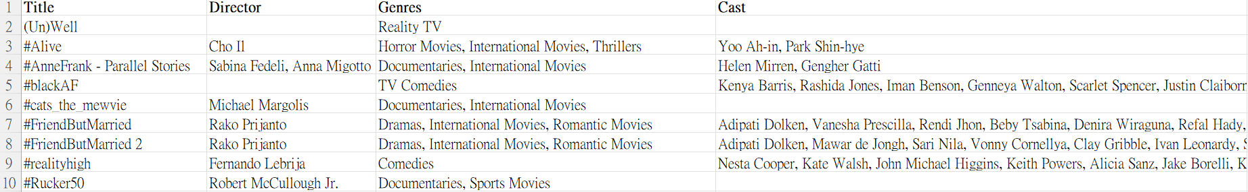
Intention behind the code
Data Cleaning | Simplifying Dataset

Slide 8
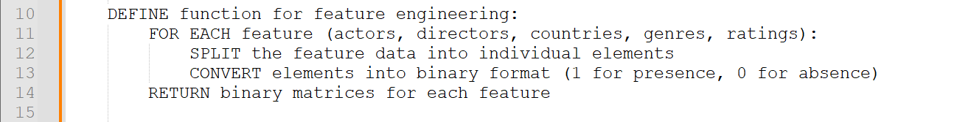
Intention behind the code
Binary Classification
Feature Engineering
Extract features and transform raw data into a structured format
Convert text data like genres into binary (0/1) representation

Slide 9
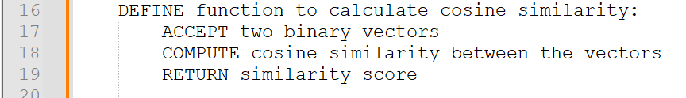
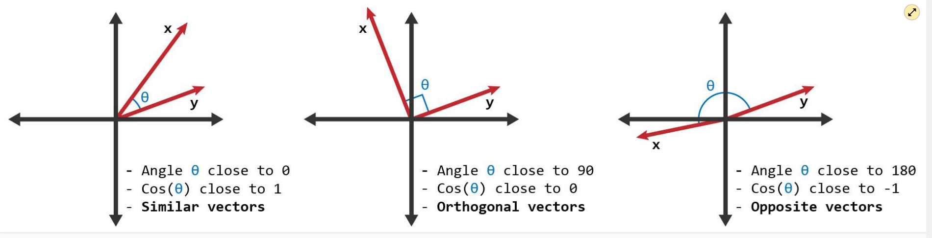
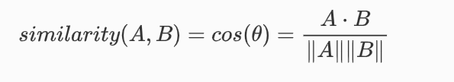
Intention behind the code
Similarity Comparison | Cosine Similarity
A metric used to measure how similar two vectors are
Provides a mathematical way to quantify how 'similar' each other are based on their attributes

Slide 10
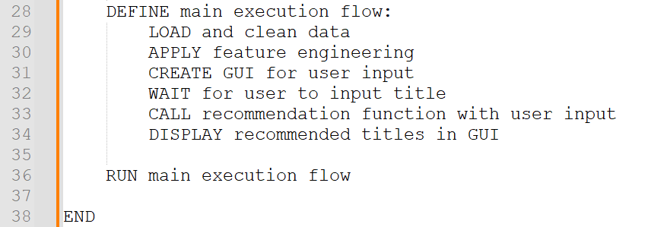
Intention behind the code

Slide 11


Slide 12
Thank you :)

